Slide 1

Cloud Computing Security Using Elliptic Curve Cryptography
by
K.Yugandhar
Roll No. 224G5A3215
B.Rohini
Roll No. 214G1A3287
B.Swaroopa
Roll No. 214G1A32B1
B.Suvarchala
Roll No. 214G1A32A9
Under the guidance of
Mr. K.Venkatesh _{M. Tech.}
Assistant Professor
Department of Computer Science and Engineering (Data Science)
Srinivasa Ramanujan Institute of Technology
(Affiliated to JNTUA & Approved by AICTE) (Accredited by NAAC with ‘A’ Grade & Accredited by NBA (EEE, ECE & CSE)
Rotarypuram Village, B K Samudram Mandal, Ananthapuramu – 515701.
2024 - 2025

Slide 2

Contents
Abstract
Introduction
Literature survey
Proposed Work
References
GitHub Link
Queries

Slide 3
Abstract
Cloud data security and retrieval efficiency by integrating Elliptic Curve Cryptography (ECC) into cloud storage systems. ECC provides enhanced security with smaller key sizes and lower computational overhead compared to RSA cryptography, making it an ideal choice for secure cloud environments. The system employs advanced cryptographic techniques to ensure role-based and attribute-based access control, enabling only authorized users—such as data owners or specific organizational departments—to search encrypted cloud-stored data. Moreover, the inclusion of automated audit log updates improves transparency and system integrity, fostering trust in cloud services. This approach not only strengthens data confidentiality and access control but also improves search efficiency and scalability, making it a robust solution to existing security gaps. By addressing these issues, the study paves the way for advanced cloud data management, with implications for industries reliant on secure, efficient, and scalable cloud computing infrastructures. The use of Elliptic Curve Cryptography improves cloud data security, access control, search efficiency, and enabling advanced management.
Keywords: Elliptic Curve Cryptography, Role-Based Access Control (RBAC), Attribute-Based Access Control (ABAC), Automated audit logs

Slide 4
Introduction
ECC enhances cloud data security: Elliptic Curve Cryptography (ECC) provides superior encryption strength with smaller key sizes, ensuring robust data protection in cloud environments.
Improves data retrieval efficiency: ECC minimizes computational overhead while maintaining high security, optimizing cloud systems for faster, more efficient data access and retrieval.
Secure, authorized data access: Through role-based and attribute-based access controls, ECC enables secure, restricted access to sensitive cloud data, ensuring proper authorization.
Automatic audit log updates: ECC-based systems automatically update audit logs, enhancing transparency, maintaining system integrity, and tracking all data access and actions.

Slide 5
Literature Survey
No | Title | Author | Journal Name & Year | Methodology Adapted | Key Findings | Gaps
1. | Use of cryptography in cloud computing | Aws Jaber, M. F. Bin Zolkipli | IEEE Int. Conf. Control Syst & 2013 | Encryption & Decryption | AES algorithm | Only single keys is used.
2 | Data Security in Cloud Environment Using End-to-End Encryption | Hitesh Vasudev, Dhiraj Kapila | IEEE E3S Web of Conferences, | Hybrid Cryptography | RSA and DES, RSA and AES | Combination of 2 algorithms are using in this criteria.
3 | Data Security in Cloud Computing | Imran A. Khan, Rosheen Qazi | IJCCN & 2019 | Asymmetric encryption | RSA & ECC algorithm | Providing high security to the cloud data.

Slide 6
Proposed System
The proposed system integrates Elliptic Curve Cryptography (ECC), providing enhanced security with smaller key sizes compared to RSA, resulting in faster encryption and decryption processes.
It incorporates role-based and attribute-based authorization mechanisms, ensuring secure, precise access control for different types of users in the cloud environment.
The system includes automatic audit log updates to enhance traceability and maintain system integrity, offering a scalable, efficient, and secure cloud storage framework for optimal data security and retrieval performance.
The integration of ECC improves the scalability of cloud systems, enabling them to handle larger datasets more efficiently while maintaining robust security standards.

Slide 7
Reference
[1]. Akash Badhan, Hitesh Vasudev, Dhiraj Kapila, Himanshu, “ Data Security in Cloud Environment Using Cryptography Technique for End-to-End Encryption ”,E3S Web of Conferences, vol.556, pp.01002, 2024.
[2].A. N. Jaber and M. F. Bin Zolkipli, “ Use of cryptography in cloud computing”, Proc. - 2013 IEEE Int. Conf. Control Syst. Comput. Eng. ICCSCE 2013, no. May 2016, pp. 179-184, 2013.
[3].Harshali Zodpe, Ashok Sapkal, “ An efficient AES implementation using FPGA with enhanced security features ”, Journal of King Saud University, July 2018.

Slide 8
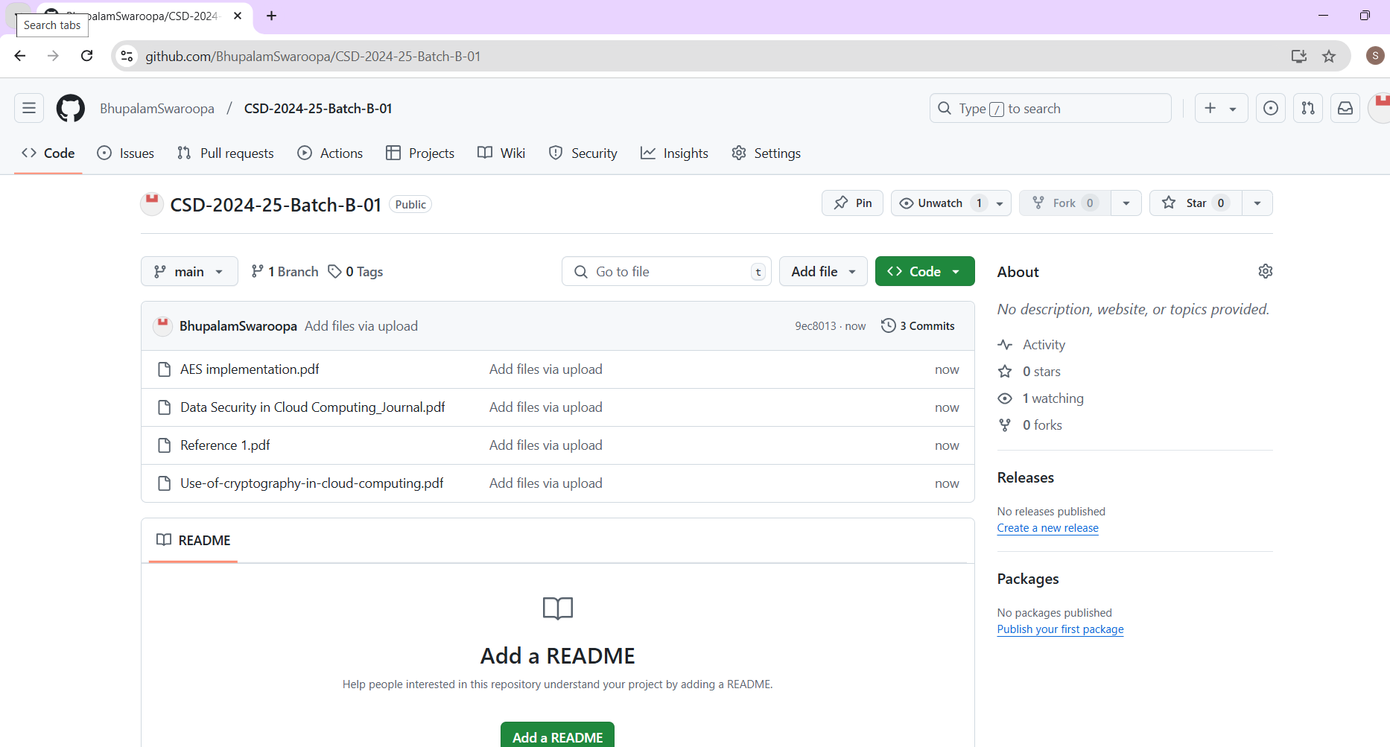

Git Hub Dashboard

Slide 9
Any Queries?

Slide 10
Thank You!!!

